Slide 1
Multisensory Continuous Psychophysics: Heading Perception is Faster but Not More Precise When Both Sound and Visual Cues are Present
Multisensory Continuous Psychophysics: Integration of Visual and Audio Cues for Direction Perception
Björn Jörges, Jong-Jin Kim, Laurence R. Harris
Center for Vision Research, York University

Slide 2


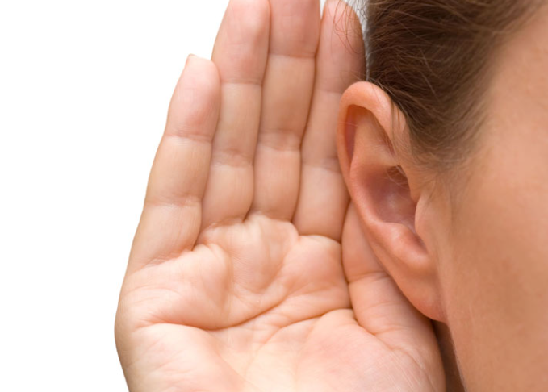
Object Localization
Multisensory process (visual, auditory, tactile, ...) to determine where an object is located
Notes:
Heading perception is a multisensory process where vision and the vestibular system play, pretty, naturally, prominent roles, but there is also evidence that other modalities, like sound or haptic information can contribute to forming more accurate and precise final percepts here.

Slide 3
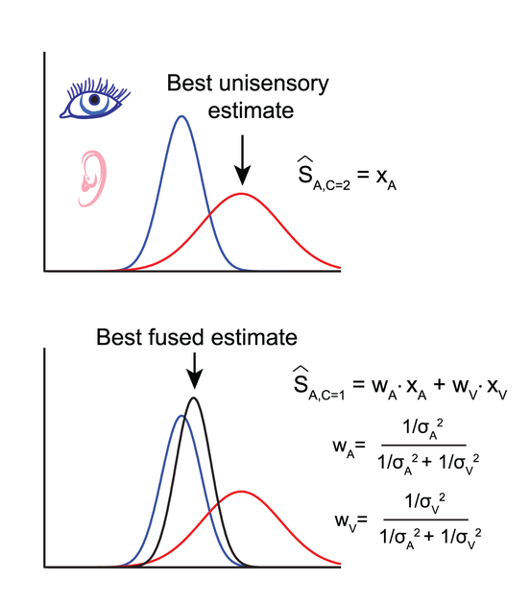
Multisensory Integration
Information from different senses is integrated according to their relative reliabilities

Slide 4
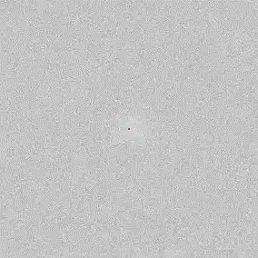
Continuous Psychophysics
Coupling a continuous stimulus with a continuous response
E.g., tracking a dot with a finger (Bonnen 2015, Décima 2022), nulling self-motion (Falconbridge 2024), eye-movements (Grillini 2022), ...
Advantages
Fast way to collect lots of data
Intuitive way to assess
time course of perception
More naturalistic
Less torturous for participants
Disadvantages
Challenging to analyze, maybe
More susceptible to influences of the motor system (Falconbridge 2024, Straub & Rothkopf 2022)

Slide 5
Aims
Validate the use of Continuous Psychophysics in multisensory integration
Sensory precision should be higher in multisensory contexts versus unisensory contexts

Slide 6
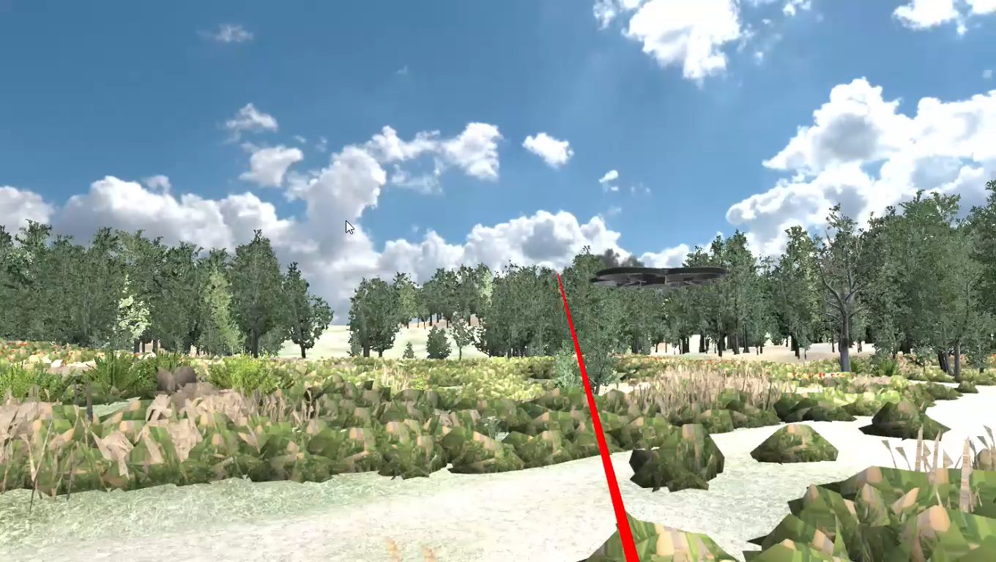
Methods
AUDIO vs. VISUAL vs. AUDIOVISUAL
3 levels of fog
n = 30
2 min of data per condition

Slide 7
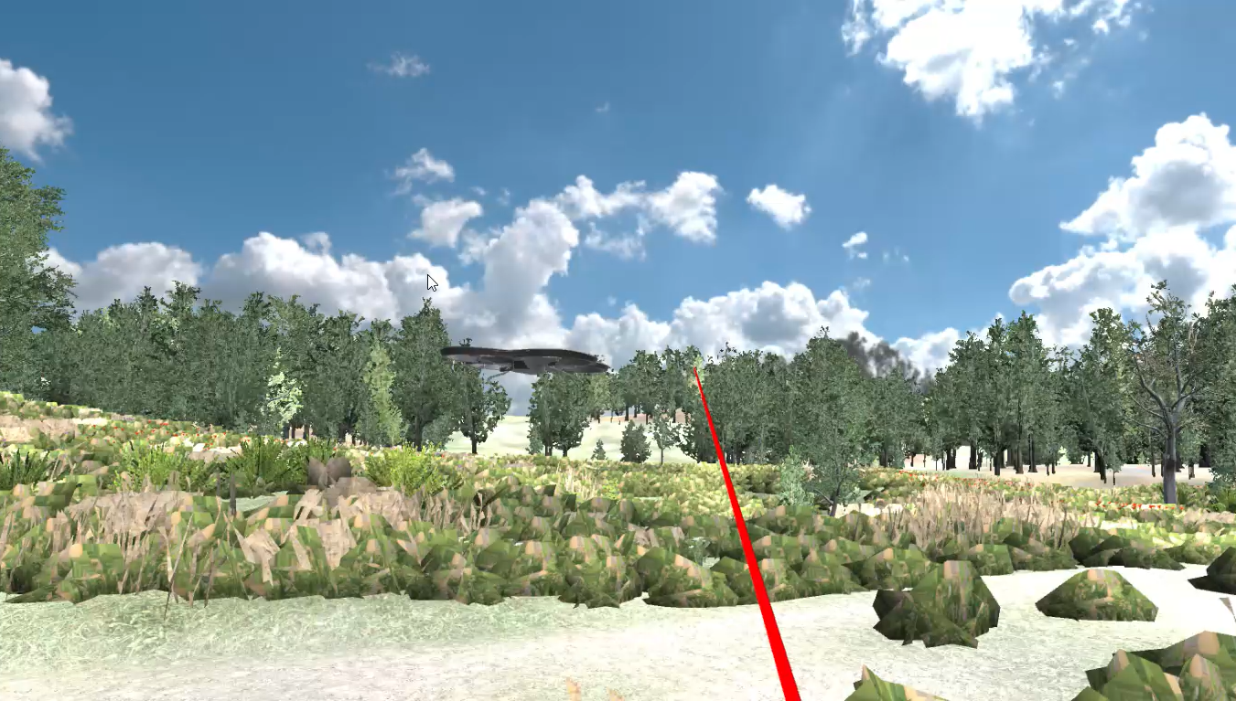
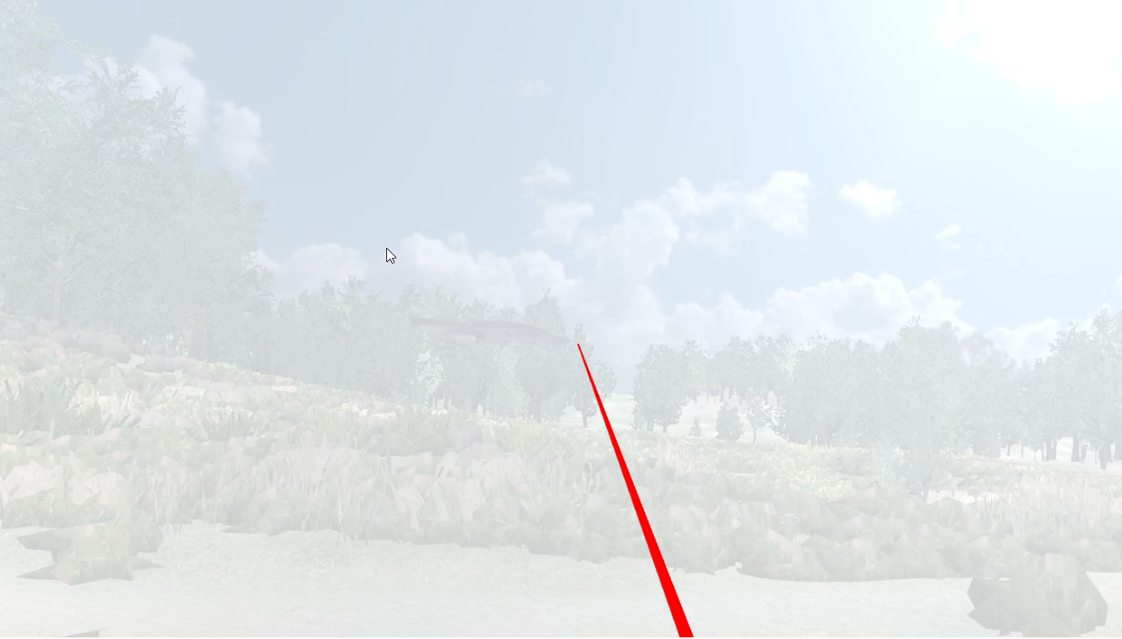
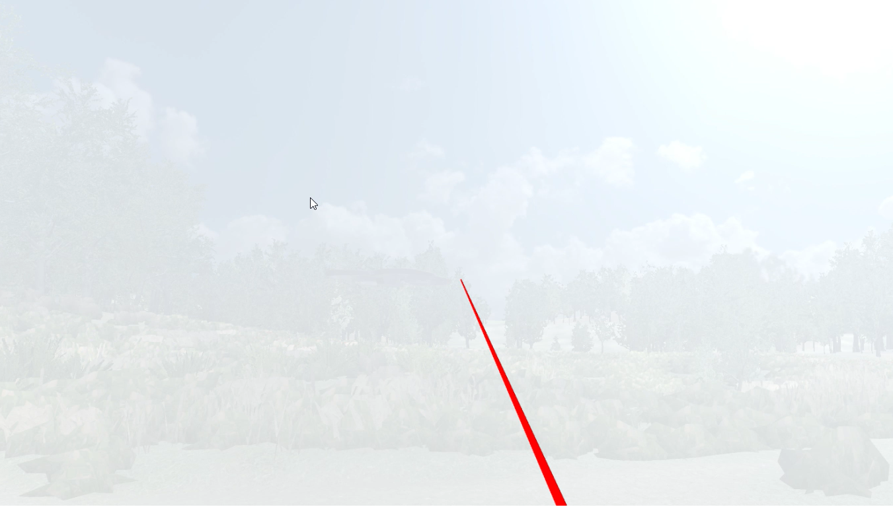
No Fog
Light Fog
Heavy Fog

Slide 8
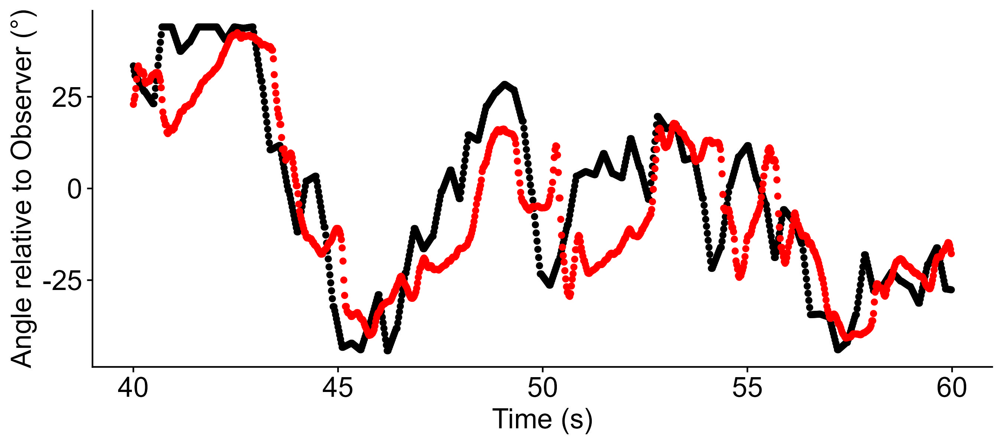
The way to the results: Raw Data
Presented Angle
Response Angle
Notes:
Now we can shift the response angles against the presented angle, and then we could compute the correlation for each lag between shown angle and response. Since we were dealing with angles here and 1° and 359° is much more similar than a correlation would assume, we went for a normalized mean error between shown angle and response. We can then plot this normalized difference between shown angle and response for each time lag and what could look as follows:

Slide 9
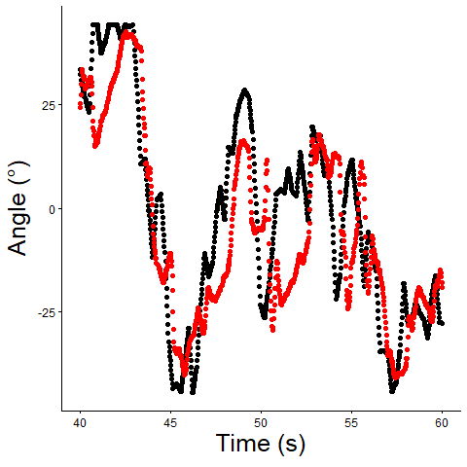
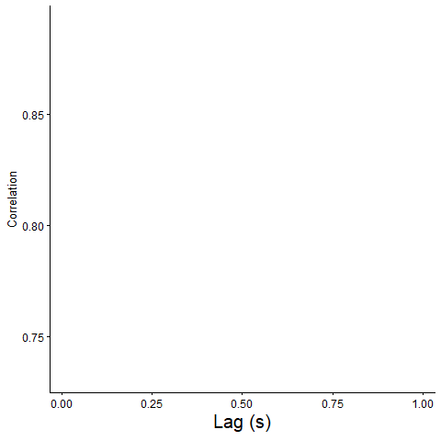
The way to the results: Cross-Correlations
Presented Angle
Response Angle
Notes:
Now we can shift the response angles against the presented angle, and then we could compute the correlation for each lag between shown angle and response. Since we were dealing with angles here and 1° and 359° is much more similar than a correlation would assume, we went for a normalized mean error between shown angle and response. We can then plot this normalized difference between shown angle and response for each time lag and what could look as follows:

Slide 10
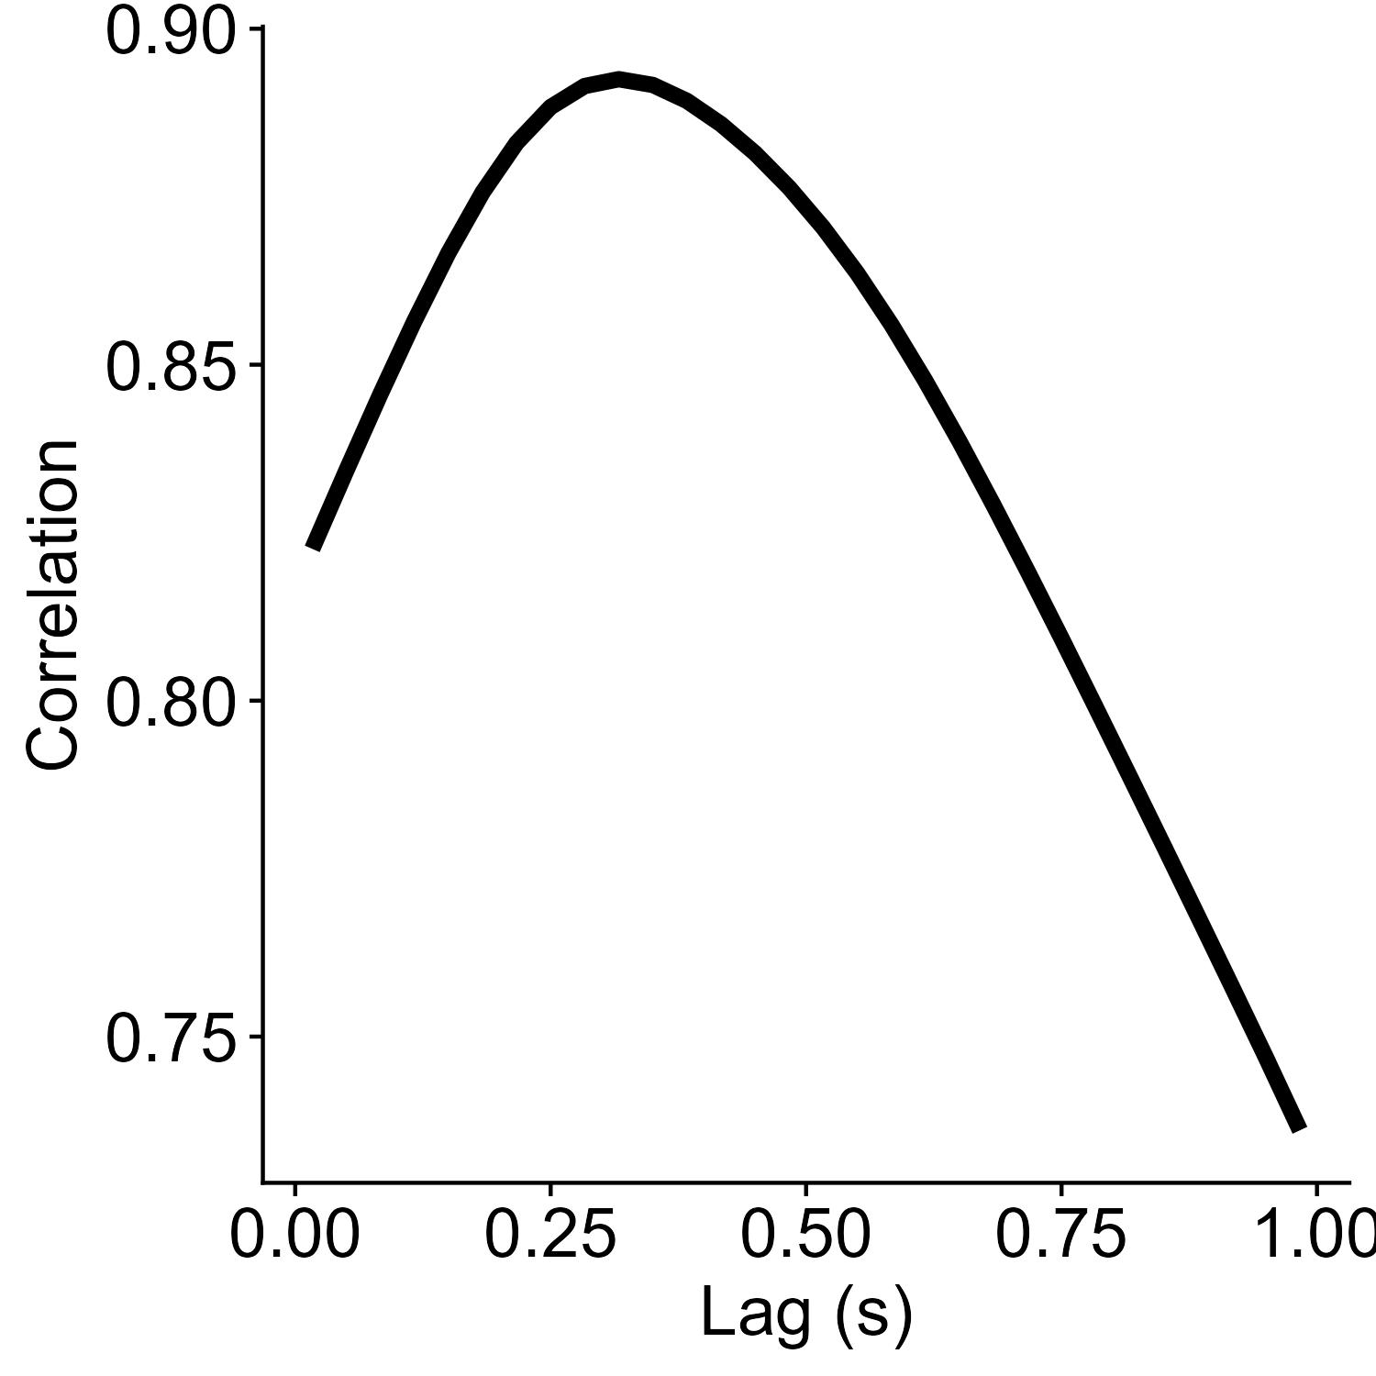
The way to the results
Maximum Correlation – How precisely are
participants able to respond to changes in heading?
Time lag of Maximum Correlation – how fast do
participants respond to changes
in direction?

Slide 11
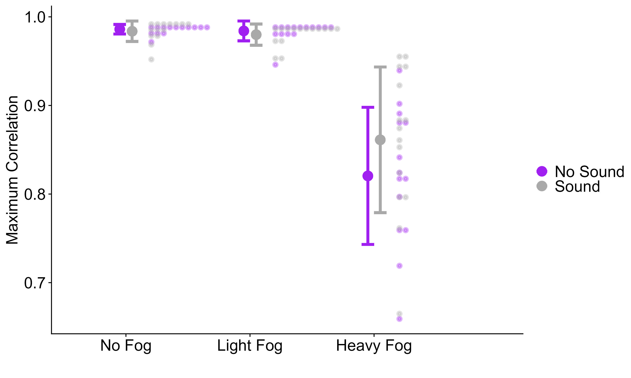
Results – Precision

Slide 12
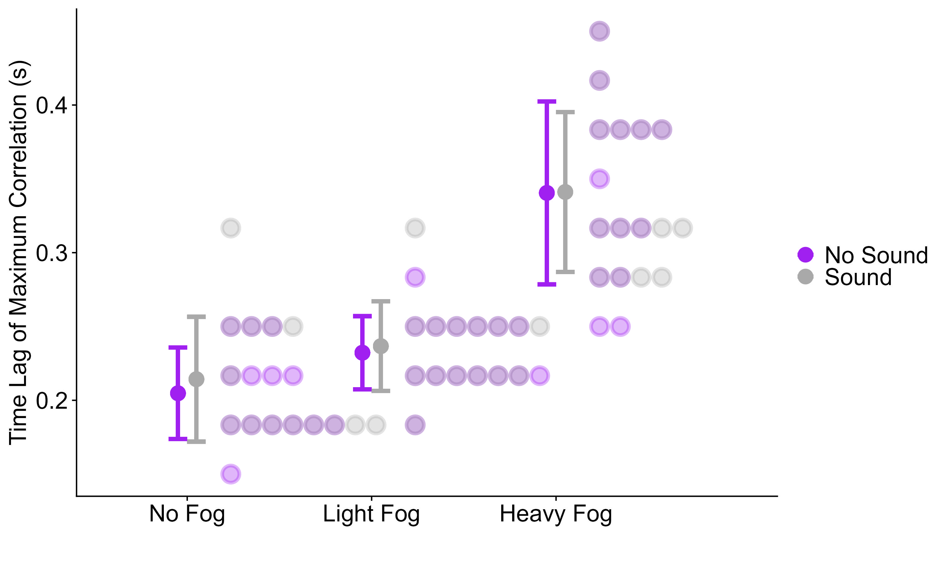
Results – Temporal Delay

Slide 13
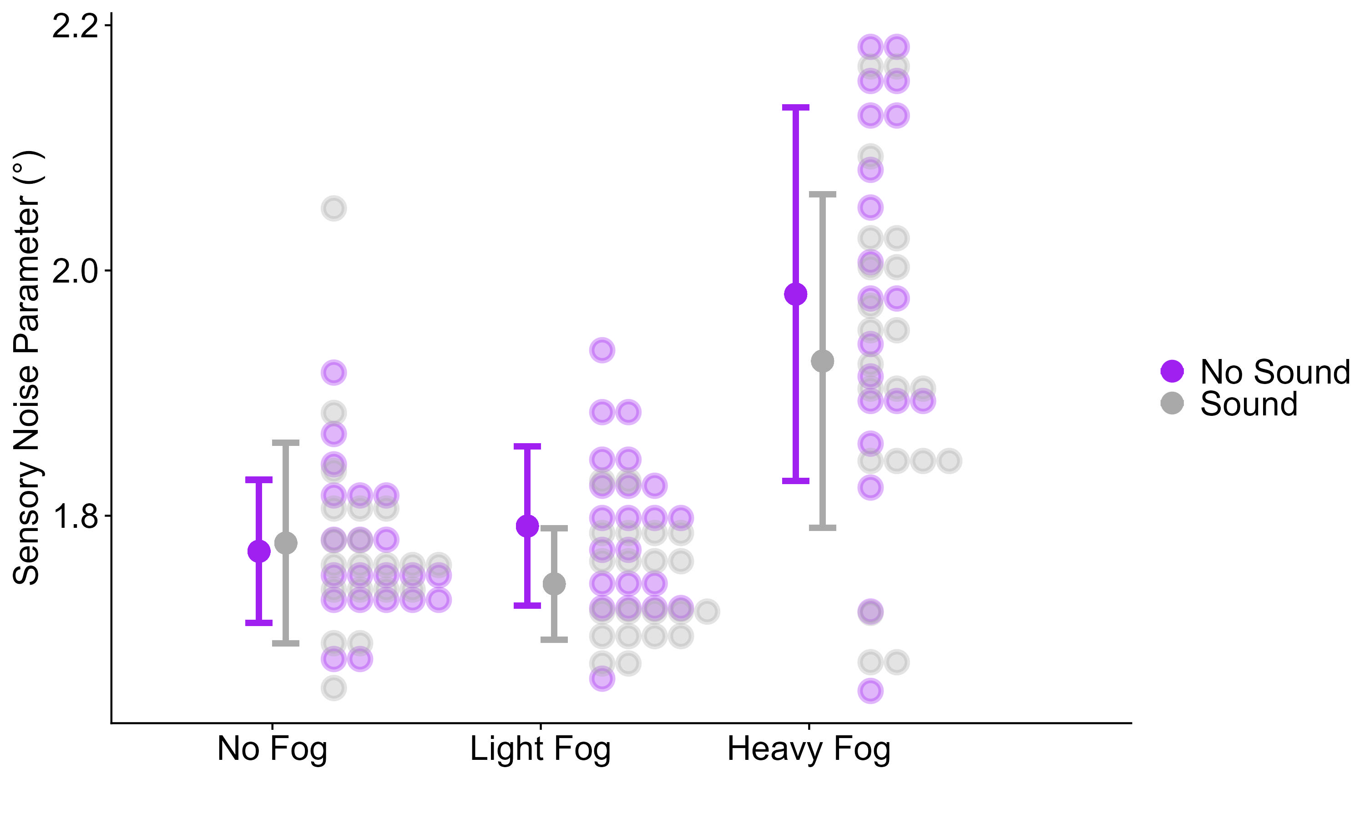
Kalman filter modelling
Kalman filters update a perceptual estimate based on the reliability of a prior and the reliability of the momentary sensory input.
Kalman filters update a perceptual estimate based on the reliability of a prior and the reliability of the momentary sensory input.
Kalman filters update a perceptual estimate based on the reliability of a prior and the reliability of the momentary sensory input.
Kalman filters update a perceptual estimate based on the reliability of a prior and the reliability of the momentary sensory input.
Notes:
The second main analysis that the authors of the seminal paper on Continuous Psychophysics performed was fitting a simple-ish Kalman filter to the data. For time reasons and since this is not the main thrust of this project, I am going to stay at an extreme surface level here and kind of just explain the Kalman filter stuff on a conceptual level. So basically, a Kalman filter maintains a perceptual estimate that it updates based on the reliability of a prior and the reliability of the momentary sensory input. Essentially, when there is not much change in the stimulus, say, for example, if we barely had an direction changes in our stimulus and participants were travelling straight-ahead most of the time, the participant would develop a pretty strong prior that there isn‘t much change in their world. Then, on the other side of the equation, we have the reliability of the momentary sensory input. So if, for example, we take our DENSE-FAST condition, we have a lot of visual information about the participants‘ heading available in any given moment. Now, if the prior is much more reliable than the sensory input, then we update very little, and if the sensory input is much more reliable than the prior, we update a lot. How do we use this model for our analysis? We have the participant‘s perceptual estimate from their responses (i.e., we know how much they update on each step), and we know that participants are fairly good at building a prior from the variability in the random walk. We can use these values and then fit parameters capturing the reliability of the sensory input for each participant and condition. And this is what you see here on the right. Higher numbers mean higher noise, and similar to our other analysis, we found that slower speeds and a more sparse environment are associated with higher sensory noise.

Slide 14
Conclusions
Validate the use of Continuous Psychophysics in multisensory integration
Sensory precision should be higher in multisensory contexts versus unisensory contexts
Validate the use of Continuous Psychophysics in multisensory integration
Sensory precision should be higher in multisensory contexts versus unisensory contexts

Slide 15
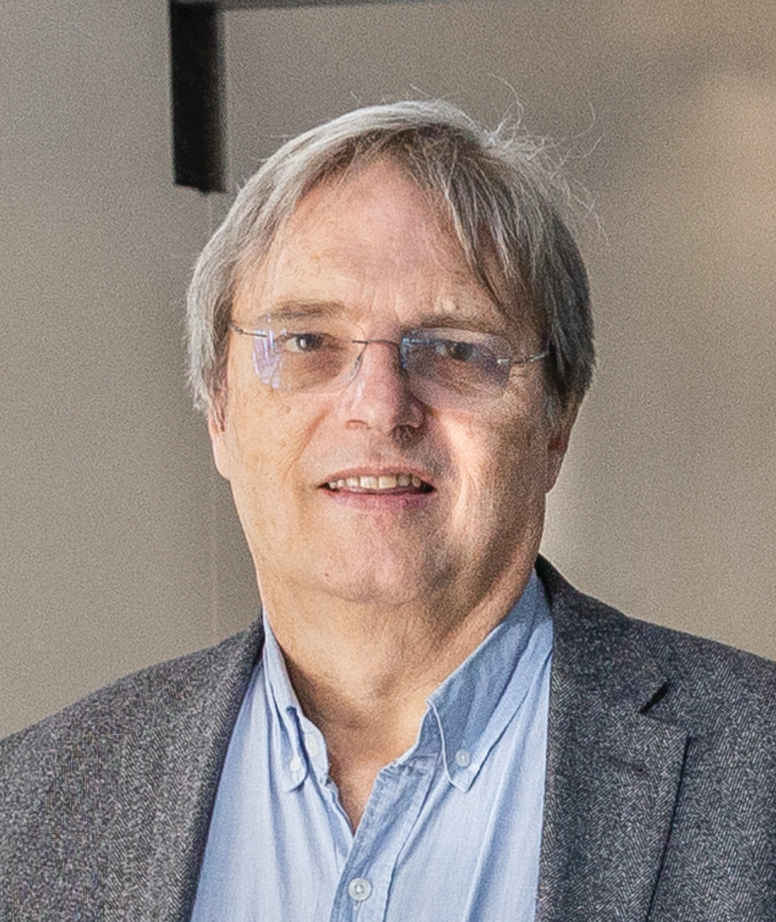

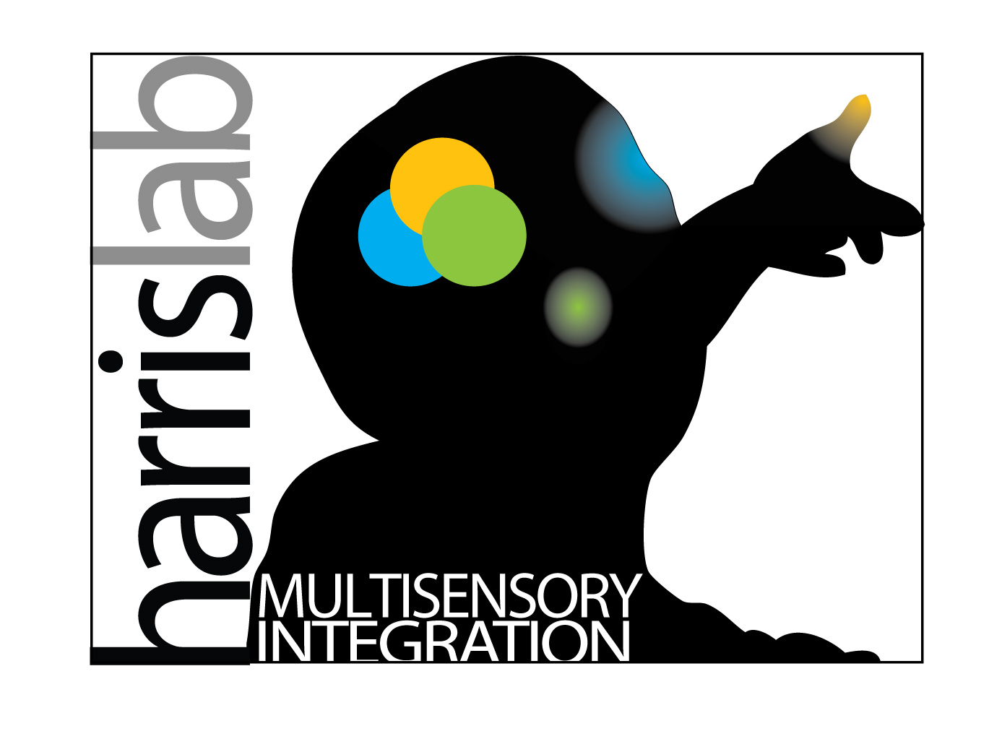



Acknowledgements
Laurence Harris
John Jong-Jin Kim

